Slide 1

Chapter1

Slide 2




Catalogue

Slide 3
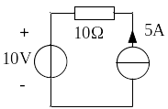
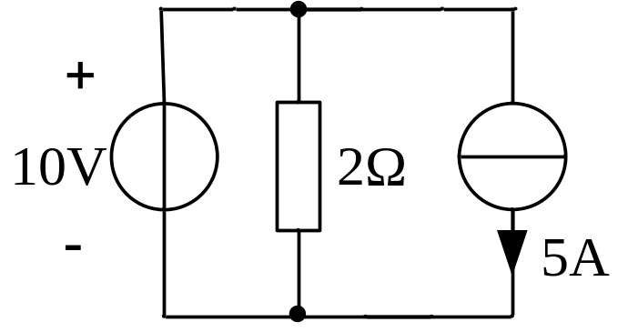


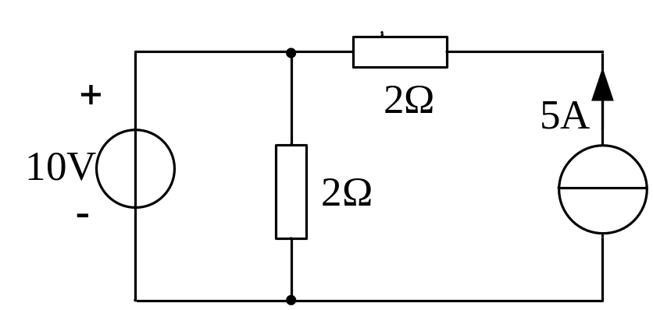
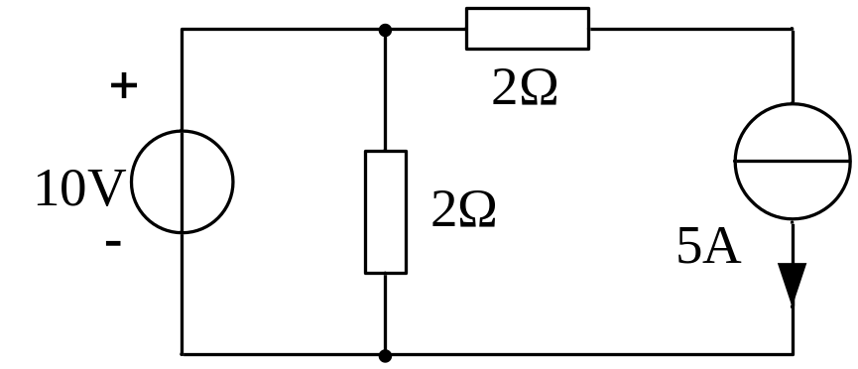
1-30 Networks are shown in Figures for question 1-30, determin the current, voltage and power for every element.

Slide 4
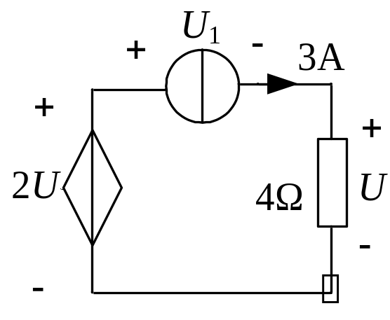
1-34 Circuit is shown in Figure for question 1-34, determin the power for every element.

Slide 5
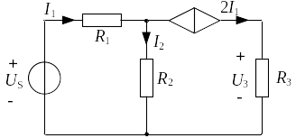
1-35 Circuit is shown in Figure for question 1-35, if U_{s}=6V,R₁=5Ω,R₂=R₃=3Ω, determine I₁ and U₃.

Slide 6
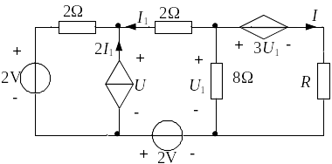
1-36 Circuit is shown in Figure for question 1-36, if I₁=0.5A, determine U, I and R.

Slide 7
Thanks!

